Slide 1
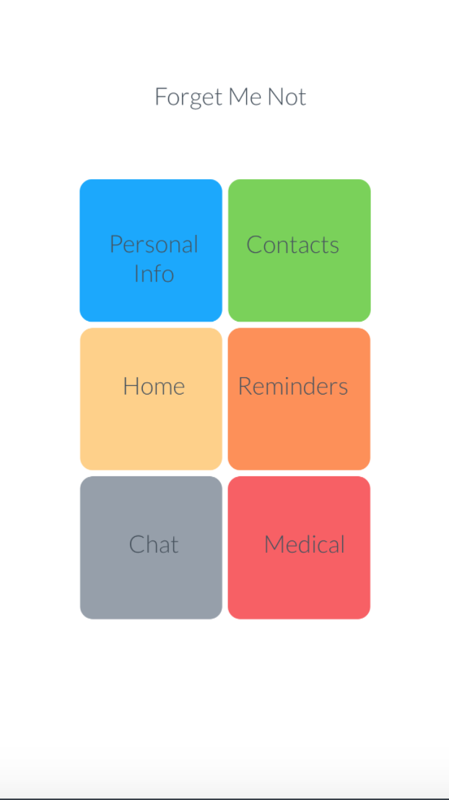
Forget Me Not
Simple
Robust
Friendly User interface

Slide 2
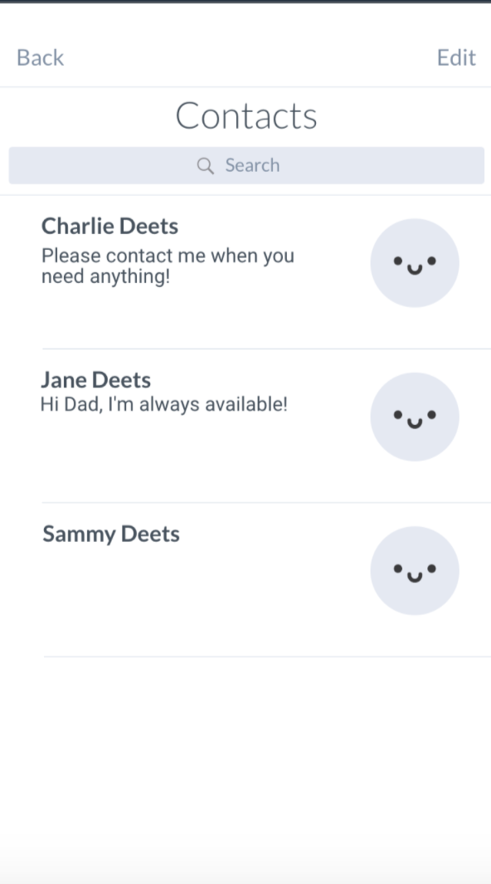
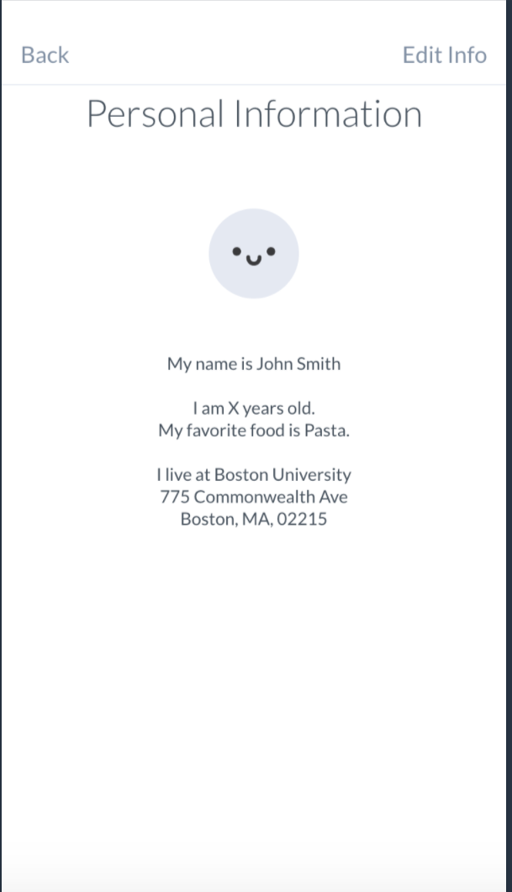
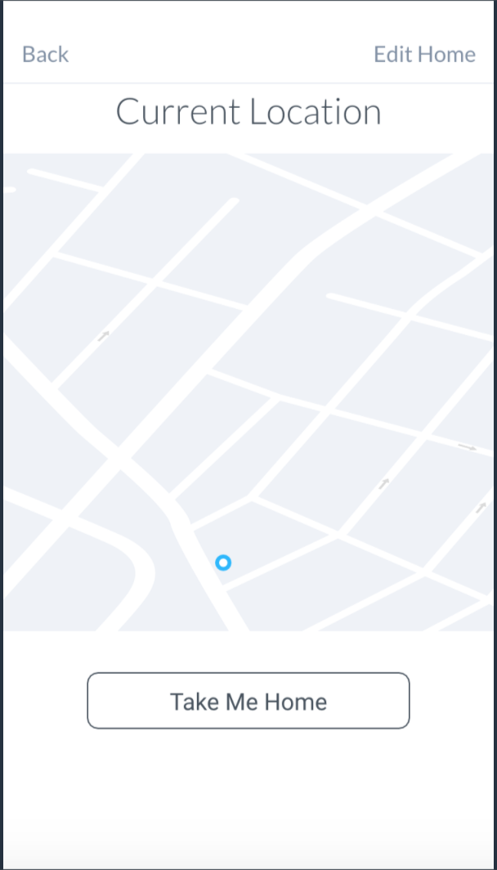
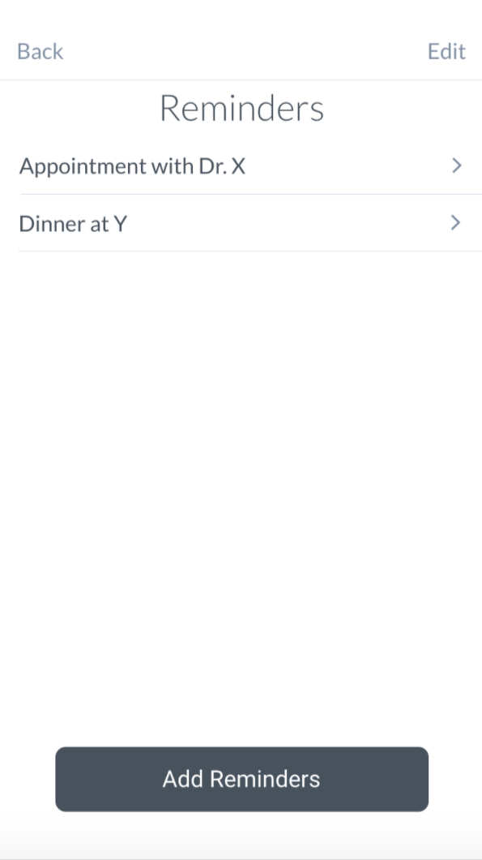
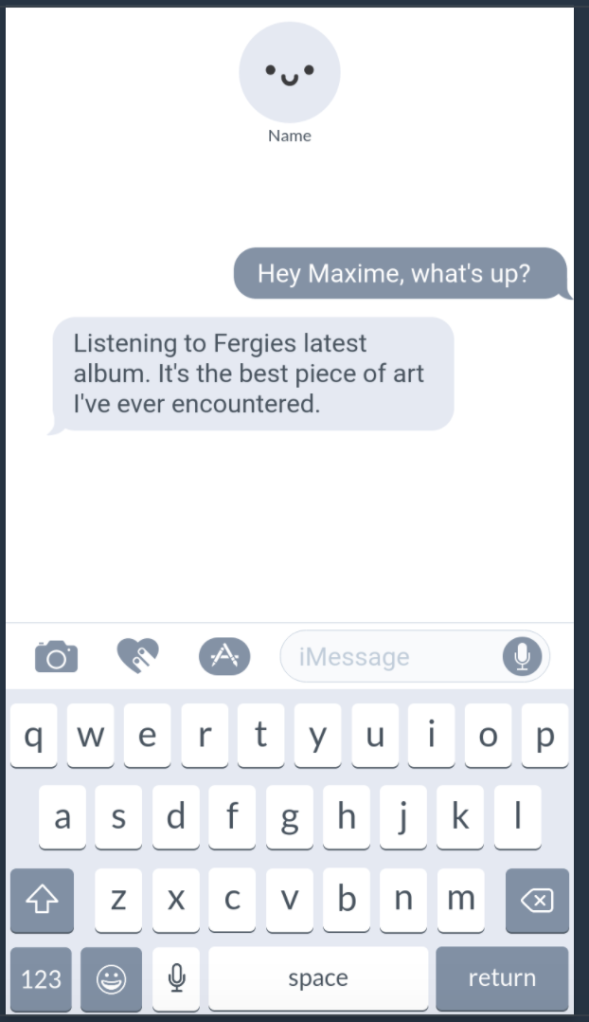
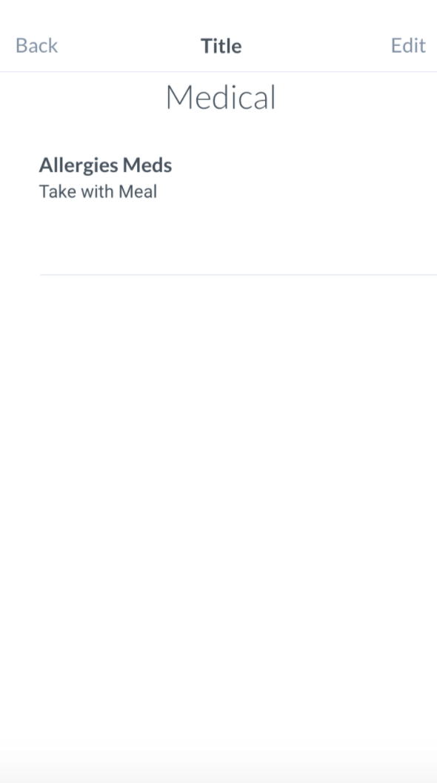

Slide 3
Personal Info
Home Address
Name

Slide 4
Family Contact
Friends etc
Name
Address
Phone number
Can enter personal message

Slide 5
Press button to navigate home
Consume google API

Slide 6
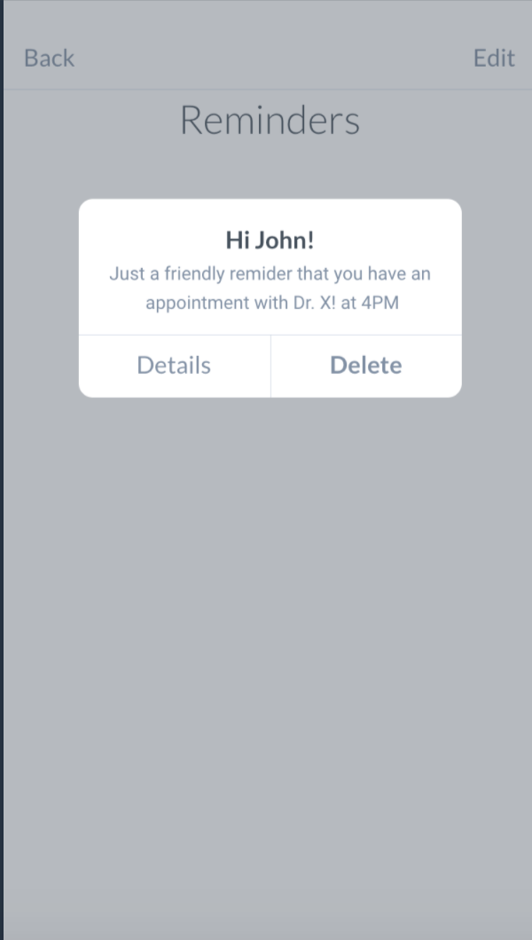
Reminders
Alert at specific time/date

Slide 7
Medication details

Slide 8
Direct Message with caretaker/family member
Can edit direct contact person

